Slide 1
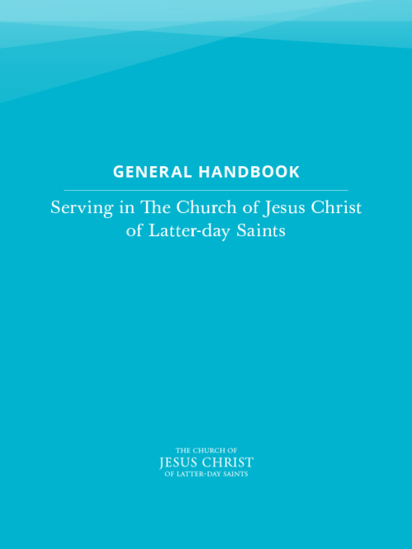
22. Providing for Temporal Needs and Building Self-Reliance
22.1 Purpose of Church Welfare
The purposes of Church welfare are to help members become self-reliant, to care for the poor and needy, and to give service.
In 1936 the First Presidency outlined a welfare plan for the Church. They said: “Our primary purpose was to set up … a system under which the curse of idleness would be done away with, the evils of a dole abolished, and independence, industry, thrift and self respect be once more established amongst our people. The aim of the Church is to help the people to help themselves. Work is to be re-enthroned as the ruling principle of the lives of our Church membership.” (in Conference Report, Oct. 1936, 3).
Notes:
Note self-reliance is a core principle since 1936. Keeping the development of God’s children in mind is a core principle. Help then comes from as close to the individual or family as possible.

Slide 2

22.1.1 Self-Reliance
Self-Reliance is the ability, commitment, and effort to provide the spiritual and temporal necessities of life for self and family. As members become self-reliant, they are also better able to serve and care for others.
Church members are responsible for their own spiritual and temporal well-being. Blessed with the gift of agency, they have the privilege and duty to set their own course, solve their own problems, and strive to become self-reliant. Members do this under the inspiration of the Lord and with the labor of their own hands.
Notes:
Note self-reliance is a core principle since 1936. Keeping the development of God’s children in mind is a core principle. Help then comes from as close to the individual or family as possible.

Slide 3
(22.1.1 continued)
When Church members are doing all they can to provide for themselves but cannot meet their basic needs, generally they should first turn to their families for help. When this is not sufficient or feasible, the Church stands ready to help.
Notes:
Note self-reliance is a core principle since 1936. Keeping the development of God’s children in mind is a core principle. Help then comes from as close to the individual or family as possible.

Slide 4
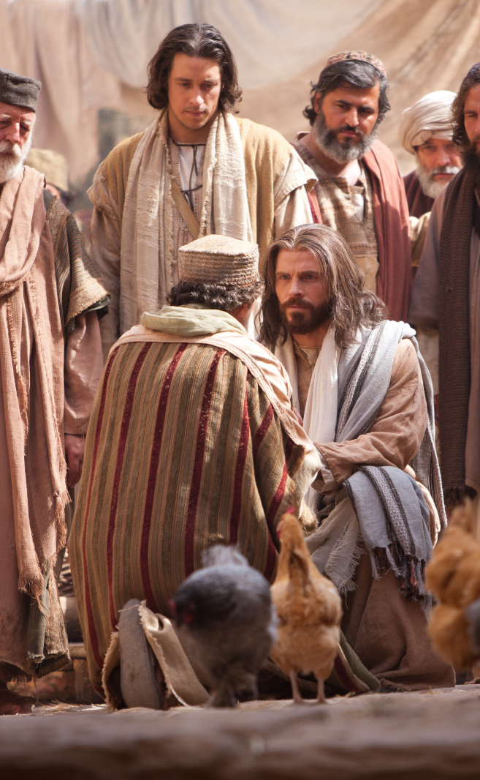
“And it is my purpose to provide for my saints, for all things are mine. But it must needs be done in mine own way; and behold this is the way that I, the Lord, have decreed to provide for my saints, that the poor shall be exalted, in that the rich are made low. For the earth is full, and there is enough and to spare; yea, I prepared all things, and have given unto the children of men to be agents unto themselves.”
Doctrine & Covenants 104:15-17

Slide 5
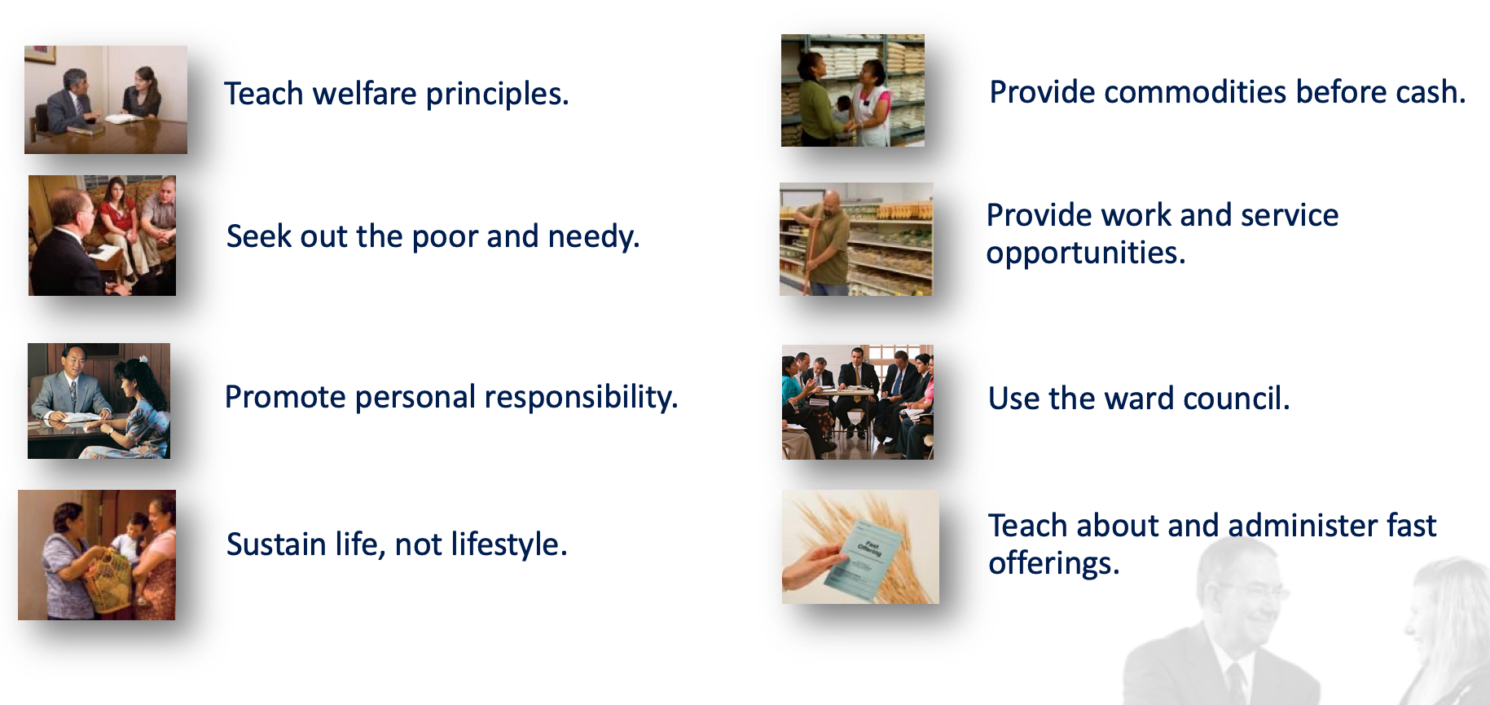
WHAT IS THE ROLE OF THE BISHOP?
22.2.1 Bishop
The bishop directs welfare work in the ward. He has a divine mandate to seek out and care for the poor (see Doctrine and Covenants 84:112). His goal is to help members help themselves and become self-reliant…

Slide 6
WHAT IS THE ROLE OF THE WARD COUNCIL?
22.2.2 Ward Council
… They counsel together about ways to help ward members understand and follow principles of welfare.
They report on spiritual and temporal welfare needs in the ward, drawing information from personal visits and from ministering interviews. When information may be too confidential to share with the entire ward council, leaders speak privately with the bishop (see 22.2.3).
They plan ways to help specific ward members meet their spiritual and temporal needs, including long-term needs. They determine how to assist members who have disabilities or other special needs. They keep these discussions confidential…

Slide 7
WHAT IS THE ROLE OF THE
ELDERS QUORUM AND RELIEF SOCIETY?
22.2.4 Elders Quorum and Relief Society
“Welfare is central to the work of the elders quorum and the Relief Society. In elders quorum and Relief Society presidency meetings, leaders plan ways to teach principles of self-reliance and service and to address welfare needs. Under the direction of the bishop, these leaders help members become self-reliant and find solutions to short-term and long-term welfare concerns.”
Notes:
How are your Elder’s and RS doing in teaching the principles of self-reliance and addressing welfare needs to move members toward self-reliance?

Slide 8
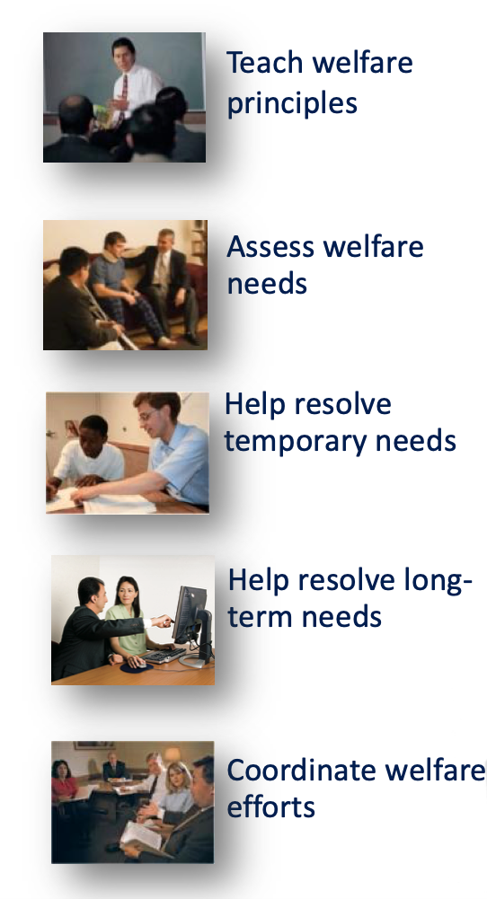
WHAT IS THE ROLE OF THE
ELDERS QUORUM AND RELIEF SOCIETY?

Slide 9


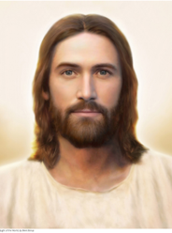
BARRIERS TO SELF-RELIANCE AND THE COVENANT PATH
“Many short-term problems are caused by long-term difficulties such as poor health, lack of skills, inadequate education or employment, lifestyle habits, and emotional challenges. Elders quorum and Relief Society leaders have a special responsibility to help members address these concerns. Their goal is to address long-term concerns in ways that lead to lasting change.”
(General Handbook, 22.2.4.2)
Notes:
PAGE 3 and 4 of the SR Leader’s Guide

Slide 10

CASE STUDY The Smithson Family
Married for 17 years
5 Children
• Separated because of a pornography addiction
• Struggling with debt and meeting financial obligations
• Divorce is being discussed
• Sister needs career but has little education/experience
• Children are struggling, one has become suicidal
What needs do the Smithson’s have?
How might the Smithson’s work to solve their own problems?
What is the role of the bishop, ward council, Relief Society or Elders Quorum?
Notes:
Presenter may alter the questions to the needs of the stake or save the discussion for later in the presentation.

Slide 11
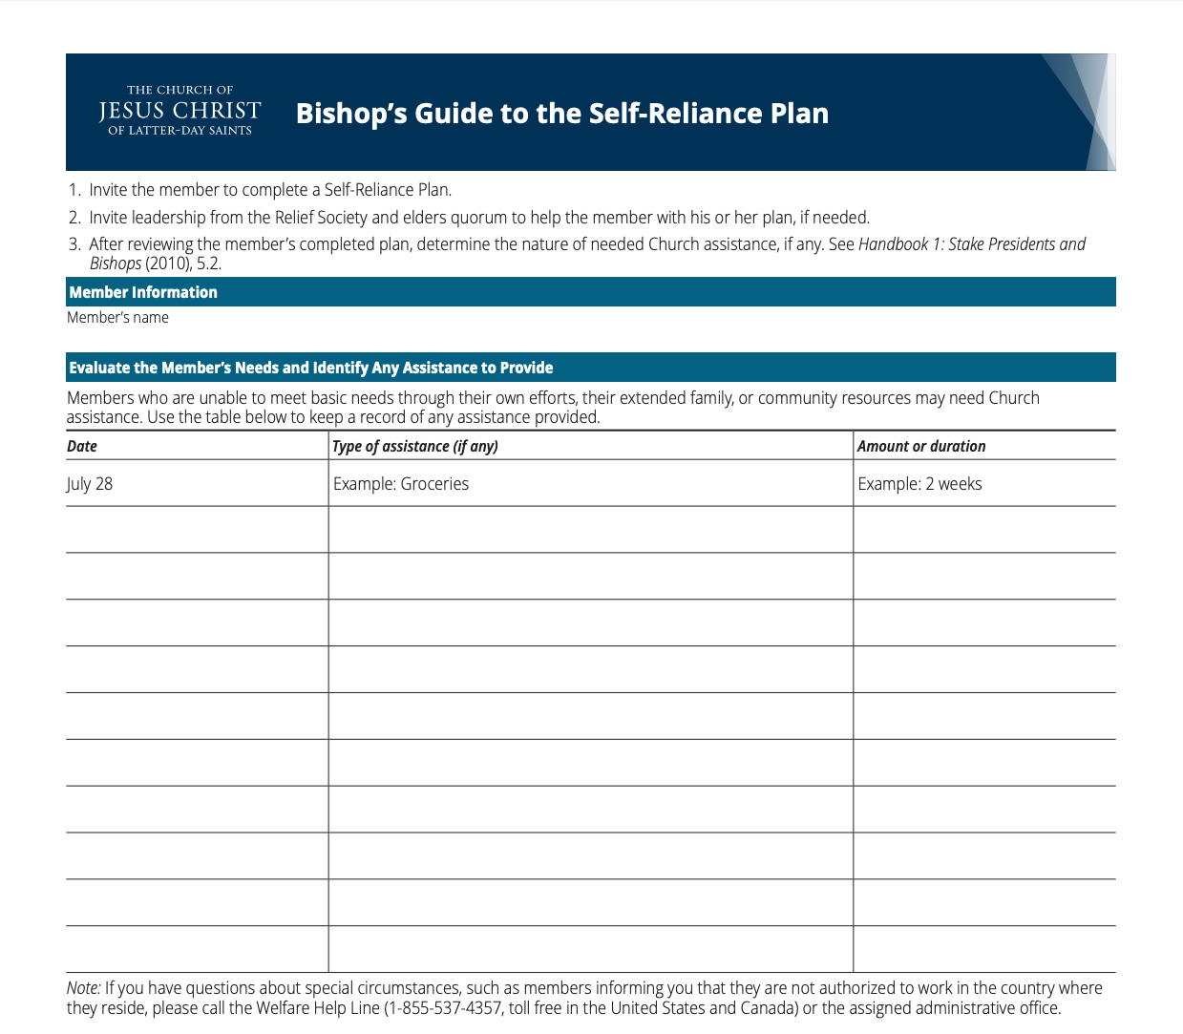
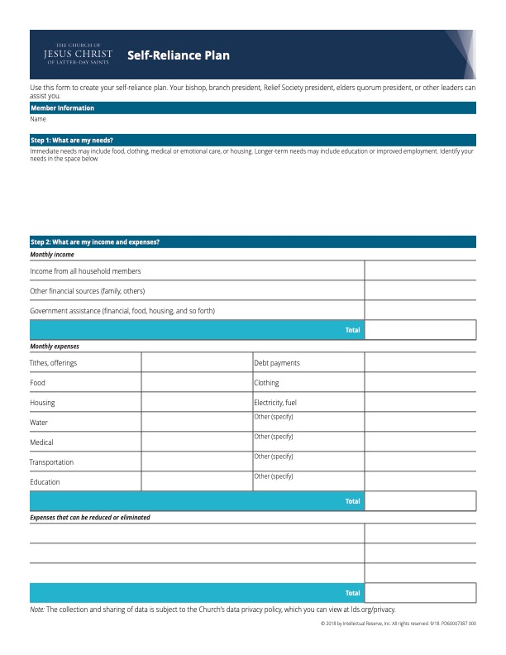
A SELF-RELIANCE FRAMEWORK
Notes:
Begin exercise to use the Self-Reliance Plan form. Walk through how to use it…

Slide 12
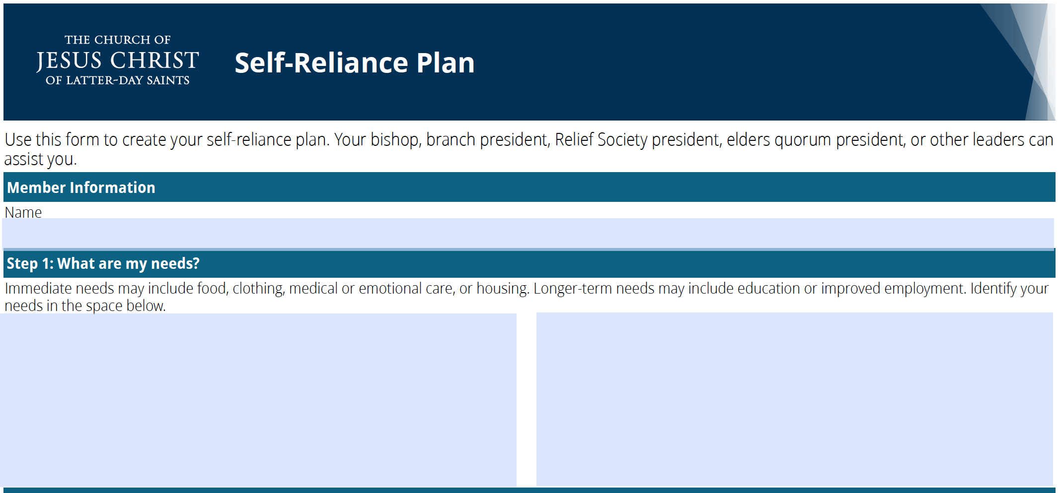

“Teach the principles of welfare ”
“Use the Ward Council”
“Assess welfare needs”

Slide 13
HELP IDENTIFY NEEDS
The Smithson Family
• Love
• Support & counseling
• Spiritual strengthening
Married for 17 years
5 Children
• Separated because of a pornography addiction
• Struggling with debt and meeting financial obligations
• Divorce is being discussed
• Sister needs career but has little education or experience
• English-language skills are a barrier to job opportunities
• Children are struggling, one has become suicidal
• Addiction counseling
• Financial assistance
• Financial education
• Marriage counseling
• Career counseling
• Career training
• Job search
• Employment
• English-language training & practice
• Mental health care & counseling
• Family counseling
• Outreach to children
Notes:
Identify the needs categories as first step

Slide 14
Gary and Jennifer Smithson
IMMEDIATE
“Help resolve temporary needs”
LONG TERM
“Help resolve long-term needs”
• Counseling: 1)suicide 2)addiction
• Financial assistance
• Employment
• Spiritual strength
• Support from family, friends and ward
• Counseling: 1)marriage 2)family
• Financial education: learn to manage finances
• Career: 1)career counseling 2)training 3)better work
• English-language training for better job opportunities

Slide 15
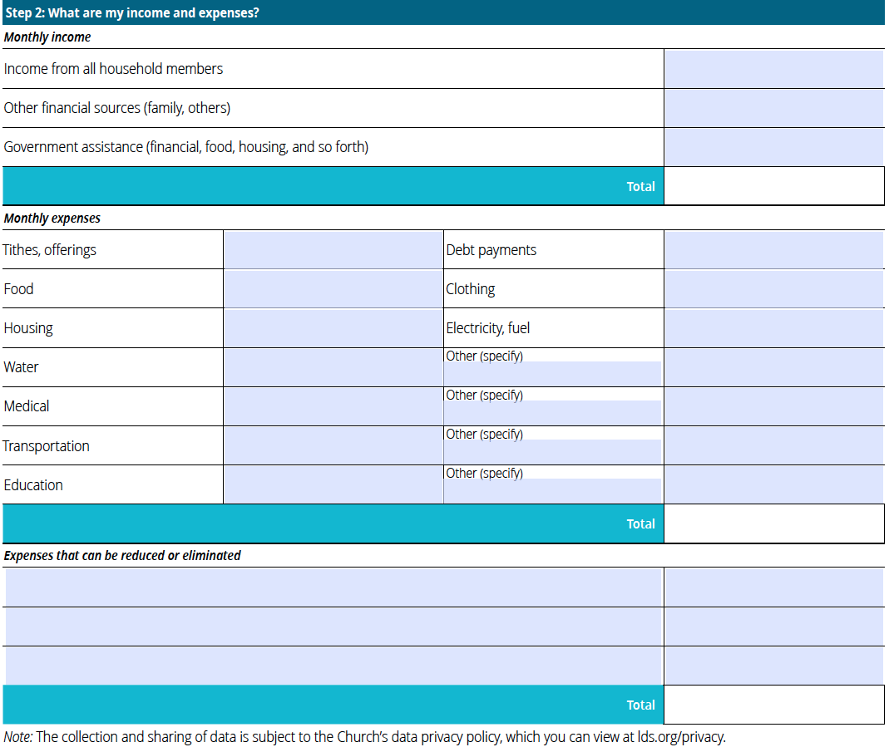
$3,800.00
“First turn to their family”
$200.00
Find short-term assistance
$150.00
How can the family
$4,150.00
increase income?
+$350
380.00
800.00
900.00
400.00
1500.00
180.00
shortfall $1,470
50.00
Cable TV, Netflix
160.00
100.00
Mobile Phones
400.00
400.00
5,270.00
reduce expenses?
-$680
Eating Out
300.00
Cable TV
”Sustain life, not lifestyle”
130.00
assistance need
reduced to
$440
Shopping for clothes
250.00
680.00

Slide 16
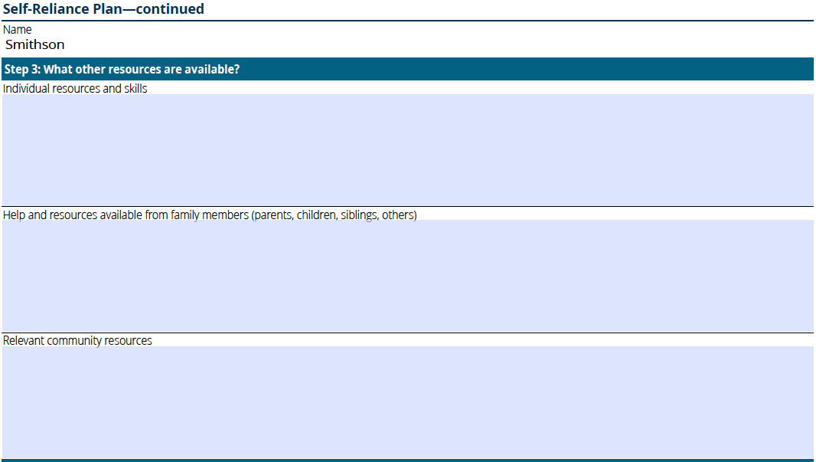
+$920 =
potential
financial
self-reliance
• Health insurance with mental health coverage
• Jennifer could get a part-time job during school hours
• Children could contribute to cellphones and clothes
• Time in the evenings on Tuesday, Thursday, Friday and Saturday
• Hold scripture study and family prayer daily
“Promote personal responsibility”
$10/hr.* 80 hrs. per month = $800
$40 per capable child per month = $120
Time to accomplish goals
Work together on spiritual strength
• Parent willing to contribute financially for a short period
• Sister, who lives nearby, will help with babysitting in the afternoons
• Extended family could help find job opportunities. Brother-in-law has job opening now
$200 x 1-2 months, share plan with parents
Where can you find community resources to help?
• Members of the ward or stake • Church programs and services
• Government assistance programs and services • Non-profit organizations
• Community service providers

Slide 17
22.1.3 The Lord’s Storehouse
“…the Lord’s storehouse is not limited to a building used to distribute food and clothing to the poor. It also includes Church member’s offerings of time, talents, compassion, materials, and financial means that are made available to the bishop to help care for the poor and needy. The Lord’s storehouse, then, exists in each ward. These offerings are ‘to be cast into the Lord’s storehouse, … every man seeking the interest of his neighbor, and doing all things with an eye single to the glory of God. (Doctrine and Covenants 82:18-19). The bishop is the agent of the Lord’s storehouse.”

Slide 18
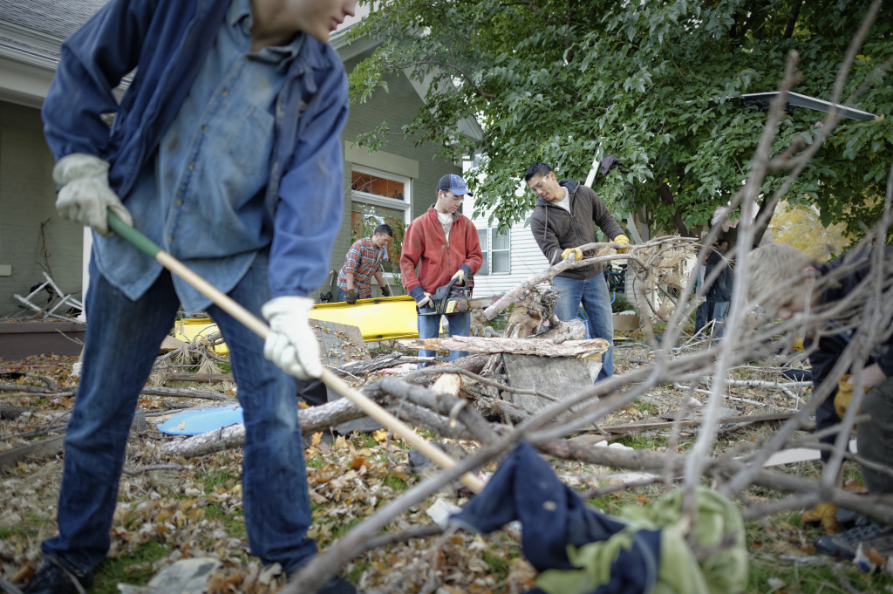

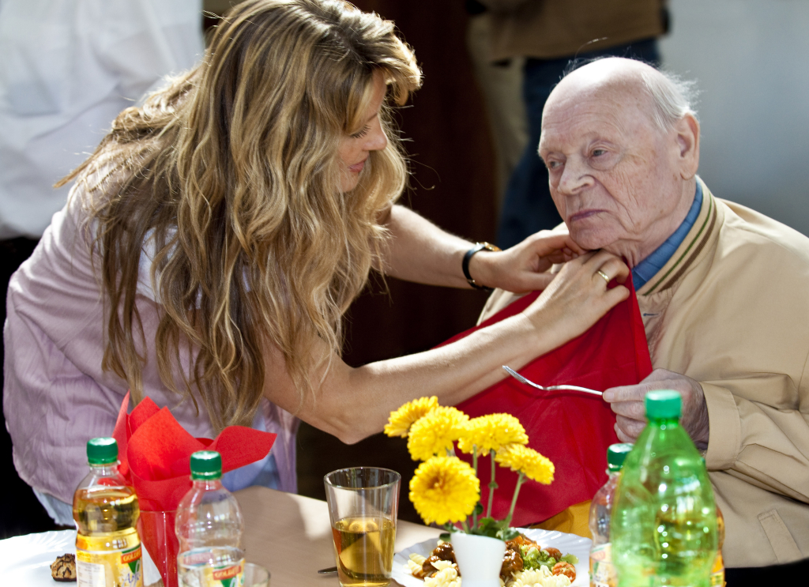
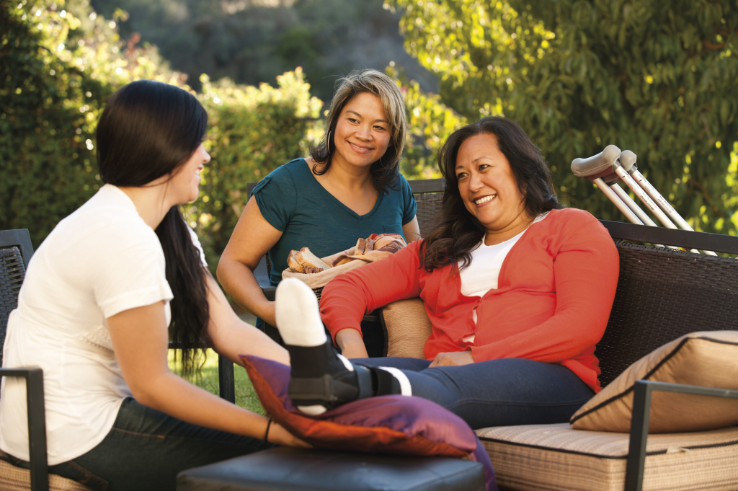
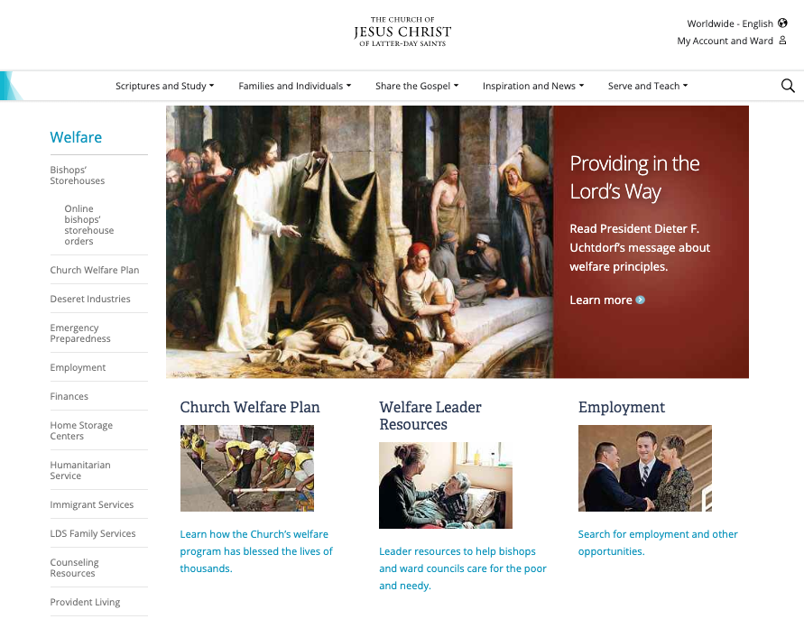
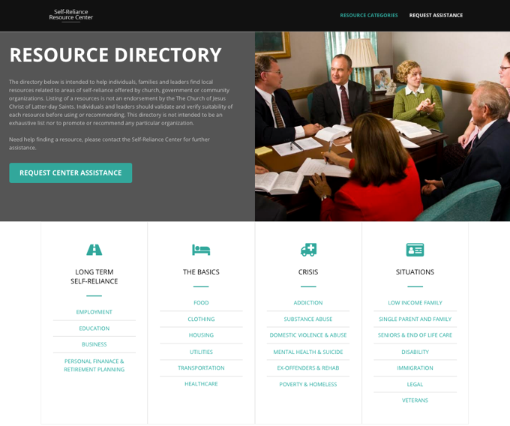

GATHERING AND SHARING RESOURCES
Ward and Stake Resources
Community & Government Resources
Build Your Own Resource Directory
Church Resources
Notes:
FOR STAKES WITH SITE
How do you identify resources? Using online resource directory. Let’s try it…

Slide 19
• Health insurance with mental health coverage
• Jennifer could get a part-time job during school hours
• Children could contribute to cellphones and clothes
• Time in the evenings on Tuesday, Thursday, Friday and Saturday
• Hold scripture study and family prayer daily
• Parent willing to contribute financially for a short period
• Sister, who lives nearby, will help with babysitting in the afternoons
• Extended family could help find job opportunities, Steve has job opening now
Mental health and addiction: Family Services-counselor referral, Addiction Recovery, suicide hotlines
Finances: budget help, Bishop’s Storehouse, DI employment, Self-Reliance group, government aid programs
Employment: BYU Pathway, local tech collage, Development Counselor, EnglishConnect

Slide 20
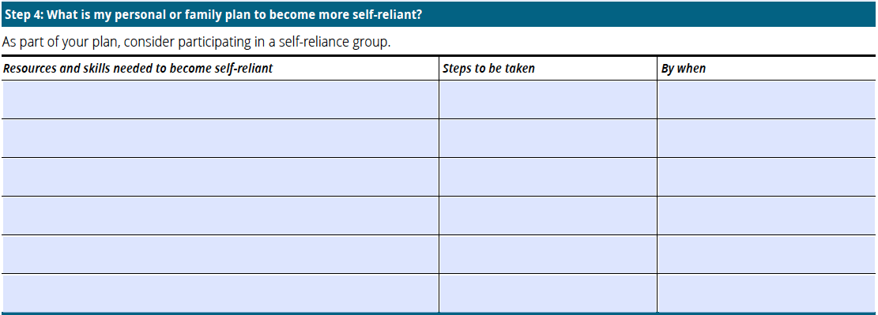
“Promote personal responsibility,” help resolve temporary and long-term needs
Good mental health, shed addiction, repair family relations
Go to counseling consultation
Thurs., Aug. 15th @10:00 AM
Control money – create budget, cut expenses – family council
Work with Bro. Jensen
Sat., Aug. 17th @ 4:30 PM
Increase income – find a job - Jennifer
Meet with Ward Emp. Spec.
Mon., Aug. 19th
Education to qualify for better job – Gary and Jennifer
Visit Emp. Center/Dev. Coun.
Wed., Aug. 21th
English-language, Personal Finance – Gary and Jennifer
Attend Self-Reliance Dev.
Sun., Aug. 25th @ 4:00 PM
Follow up with Relief Society President – family council
Meet with Sister Kelly
Tues., Sept. 6th @7:00 PM

Slide 21
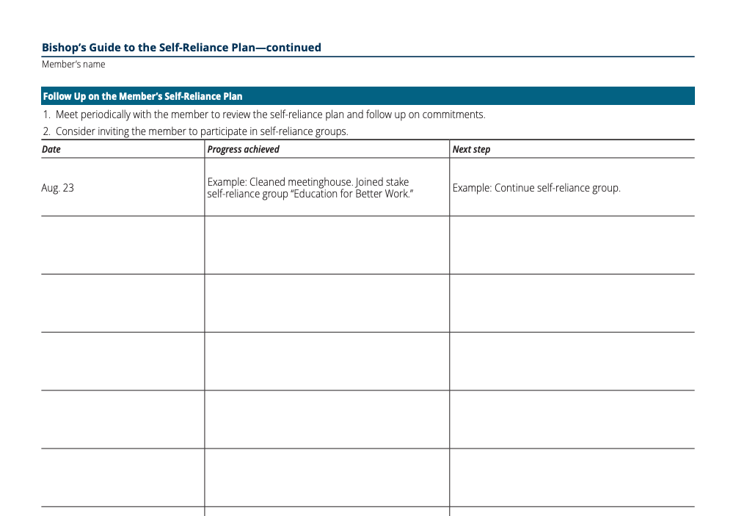
“Provide commodities before cash”
$320 in value
“Coordinate welfare efforts”

Slide 22
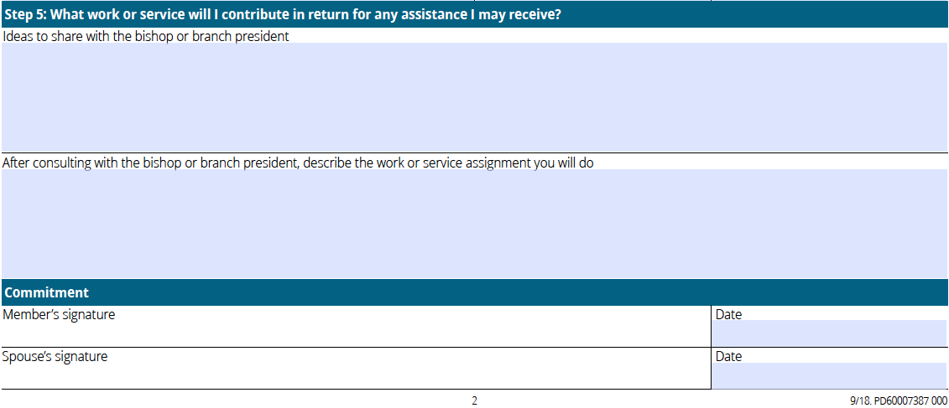
“Provide service opportunities”
• Help someone in the family
• Help someone in the ward
• Volunteer at Bishop’s Storehouse
• Help parents with yard care for 2 hours each Saturday
• Mow Sister Grant’s lawn each week
• Volunteer at the Community Action Center making food kits on Thursday nights
Notes:
JustServe is a great source of service opportunities.

Slide 23

“…wards, companies, and strengthened quorums have all required at least two things to be successful in the Lord’s intent to have His Saints care for each other in the way He cares for them. They succeed when the Saints feel the love of Christ for each other above their self-interest. The scriptures call it ‘charity … the pure love of Christ.’ And they succeed when the Holy Ghost guides the caregiver to know what the Lord knows is best for the person whom He is trying to help.”
President Henry B. Eyring, “Inspired Ministering,”
April 2018 General Conference
Notes:
Involving the Lord in the work is what distinguishes it from just any resource. With the Lord involved miracles happen. We see examples of how this works with the Self-Reliance groups.

